Slide 1
Project Title: [Shop For Home] Submitted By: [Jaya surya N] Submission Date: [05-11-2024]
Final Capstone Project Submission Report

Slide 2

Objective:
The objective of the Shop For Home project is to transition a physical home décor store to an online platform, allowing customers to browse and purchase products conveniently from home.
Description:
Shop For Home is a web application designed to facilitate online shopping for home décor products. It features a user-friendly interface, secure transactions, and robust backend functionality for product and order management.
Key Features:
User Authentication (Login, Logout, Registration)
Product Browsing by Category
Cart Management with Quantity Control
Wishlist for saving favorite products
Discount Coupons for promotional offers

Slide 3
Problem Statement
The project addresses the challenge of adapting to the COVID-19 pandemic, which has necessitated the closure of physical stores. The target audience includes home décor shoppers seeking a convenient online shopping experience.
Application Users:
Regular User:
Can browse products, add items to the cart, and complete purchases.
Admin:
Can manage user accounts, oversee product listings, and generate sales reports.
Tech Stack
Frontend: React
Backend: ASP.NET Core MVC, Web API
Database: SQL Server
ORM: Entity Framework Core
File Storage: Local or cloud storage for product images
API Documentation: Swagger

Slide 4
System Architecture
Frontend:
Built using React, components for user authentication, product listings, and cart management.
Utilizes Axios for API calls to the backend.
Backend:
Developed with ASP.NET Core, implementing RESTful API endpoints for user authentication, product management, and order processing.
Database:
Schema Overview: Contains tables for Users, Products, Cart, WishList, and Orders.
Relationships: Users have a one-to-many relationship with Orders.

Slide 5
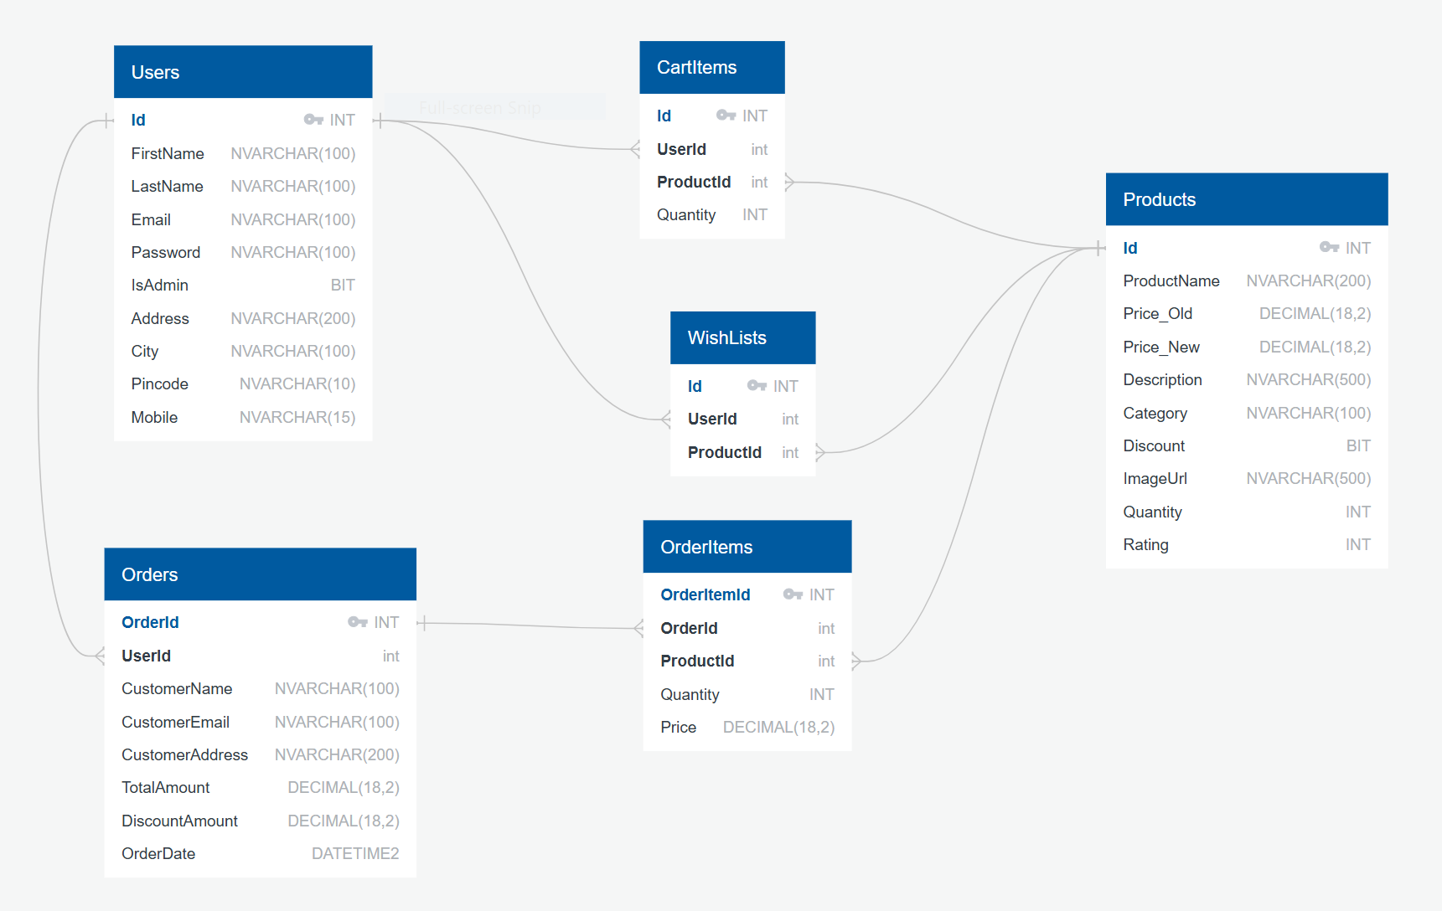
Database Schema

Slide 6
User Stories
For Regular Users:
User Authentication:
As a user, I should be able to log in, log out, and register in the application.
Browse Products:
As a user, I should be able to view products by category.
Acceptance Criteria: Users can filter products based on categories.
Add to Cart:
As a user, I should be able to add products to my cart.
Acceptance Criteria: Users can successfully add products with the desired quantity.

Slide 7
User Stories
For Admin Users:
Admin Authentication:
As an admin, I should be able to log in and access the admin dashboard.
Acceptance Criteria: Admin dashboard displays management options.
Product Management:
As an admin, I should be able to add, edit, or delete products.
Acceptance Criteria: Admin can perform CRUD operations on product listings.

Slide 8
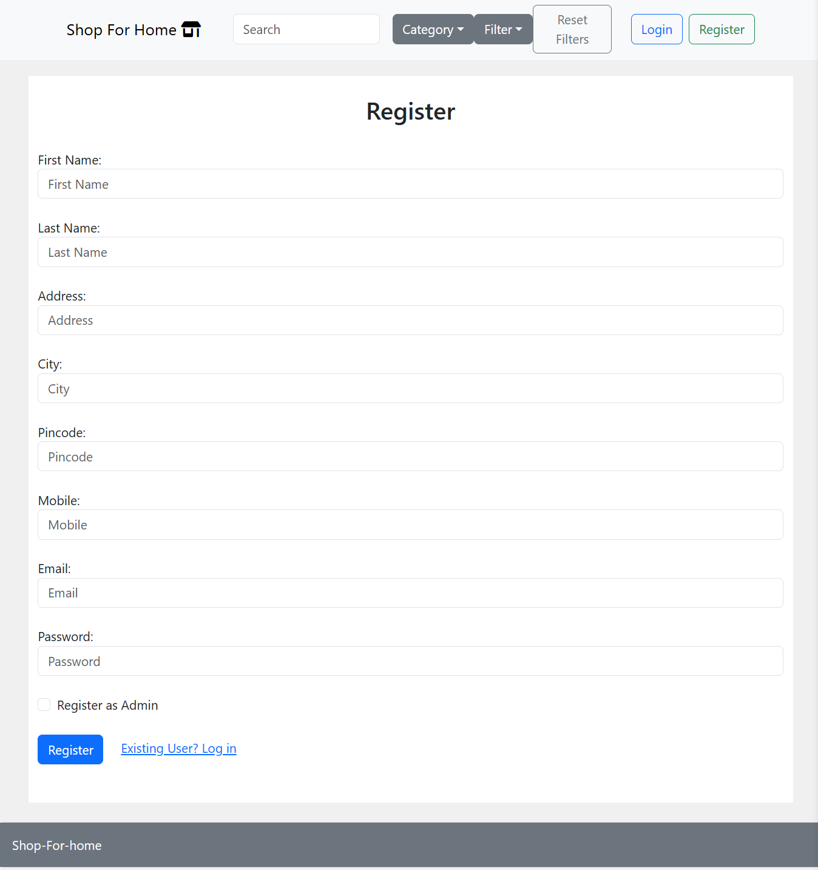
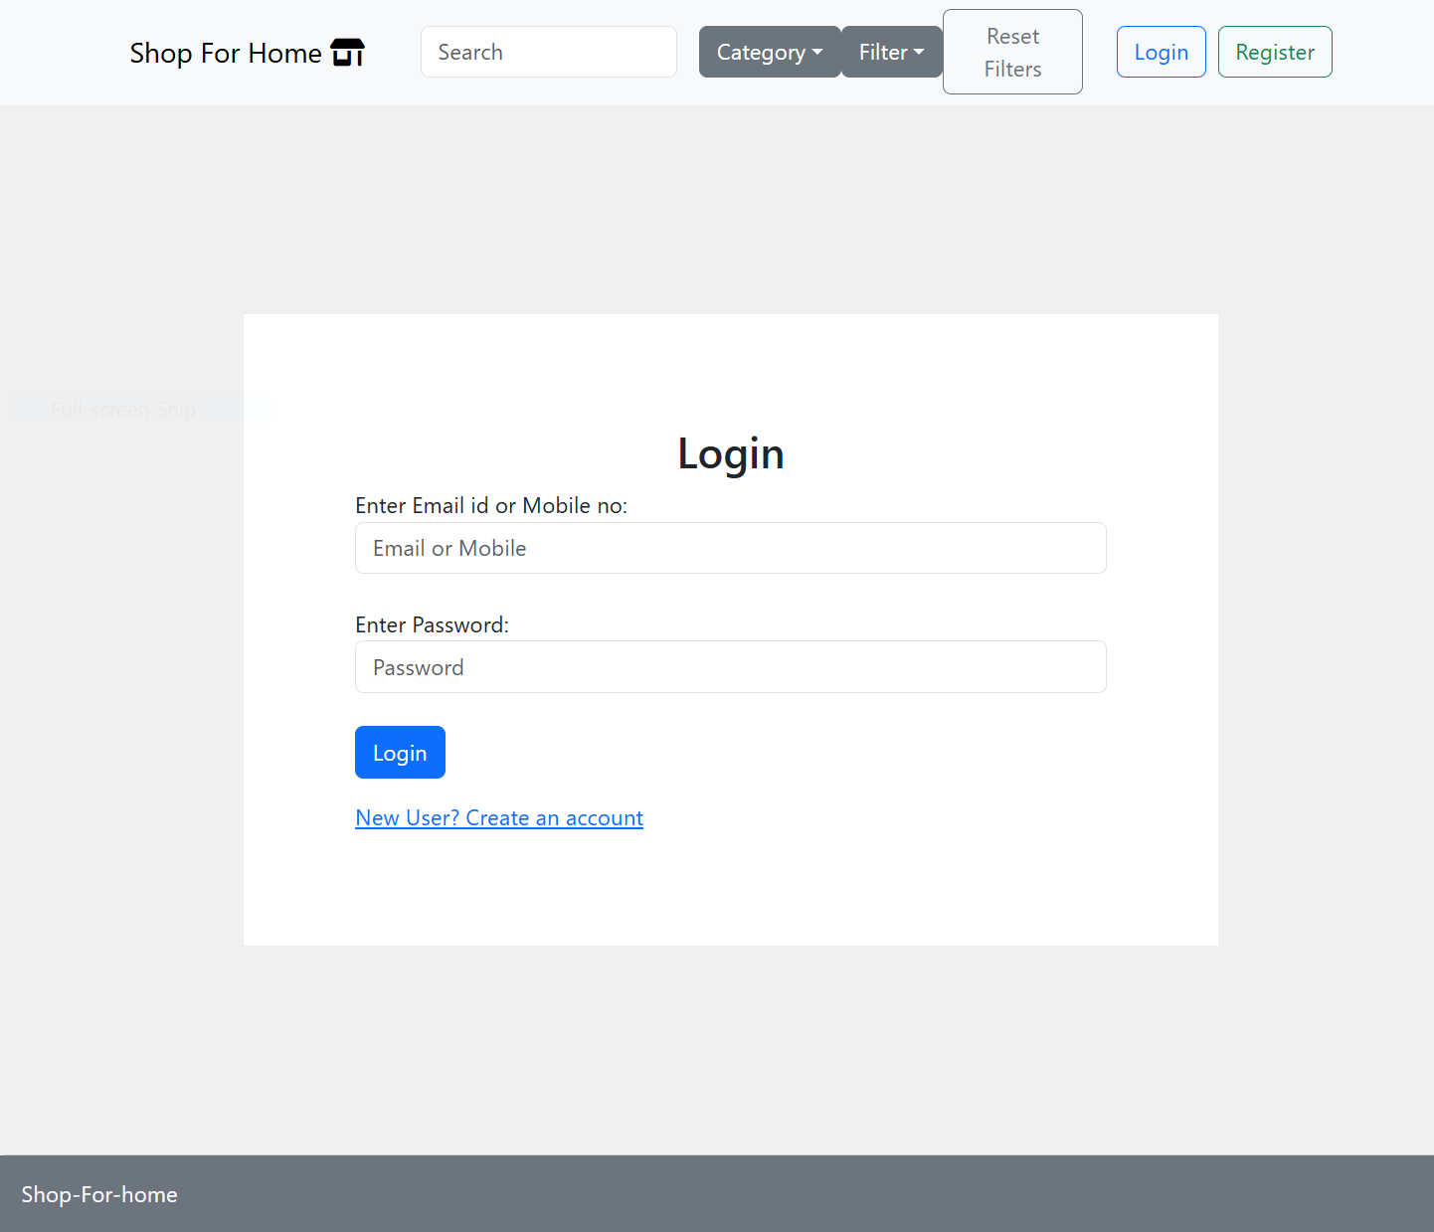
Screenshots of Implementation
User Registration & Login Screens:

Slide 9
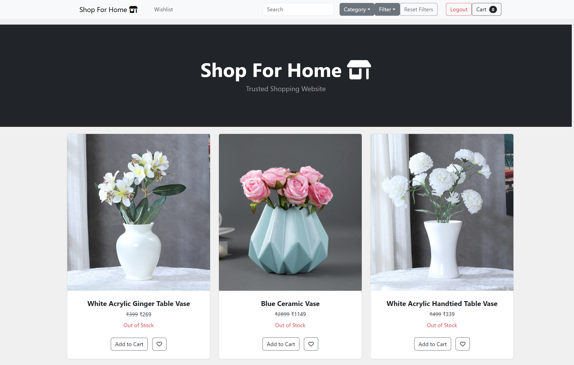
Screenshots of Implementation
Main Dashboard:

Slide 10
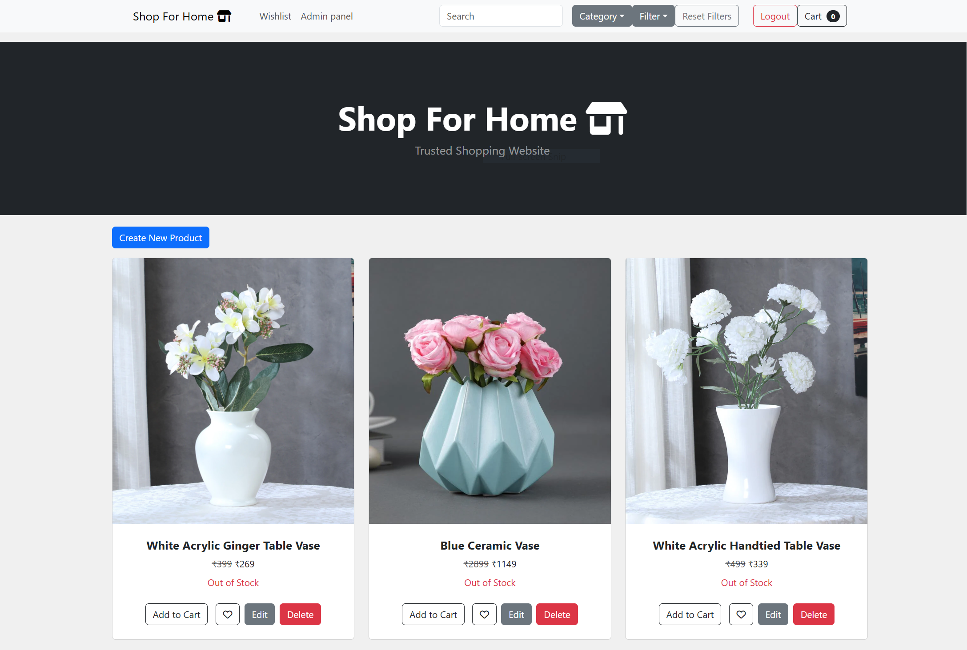
Screenshots of Implementation
Admin Dashboard:

Slide 11
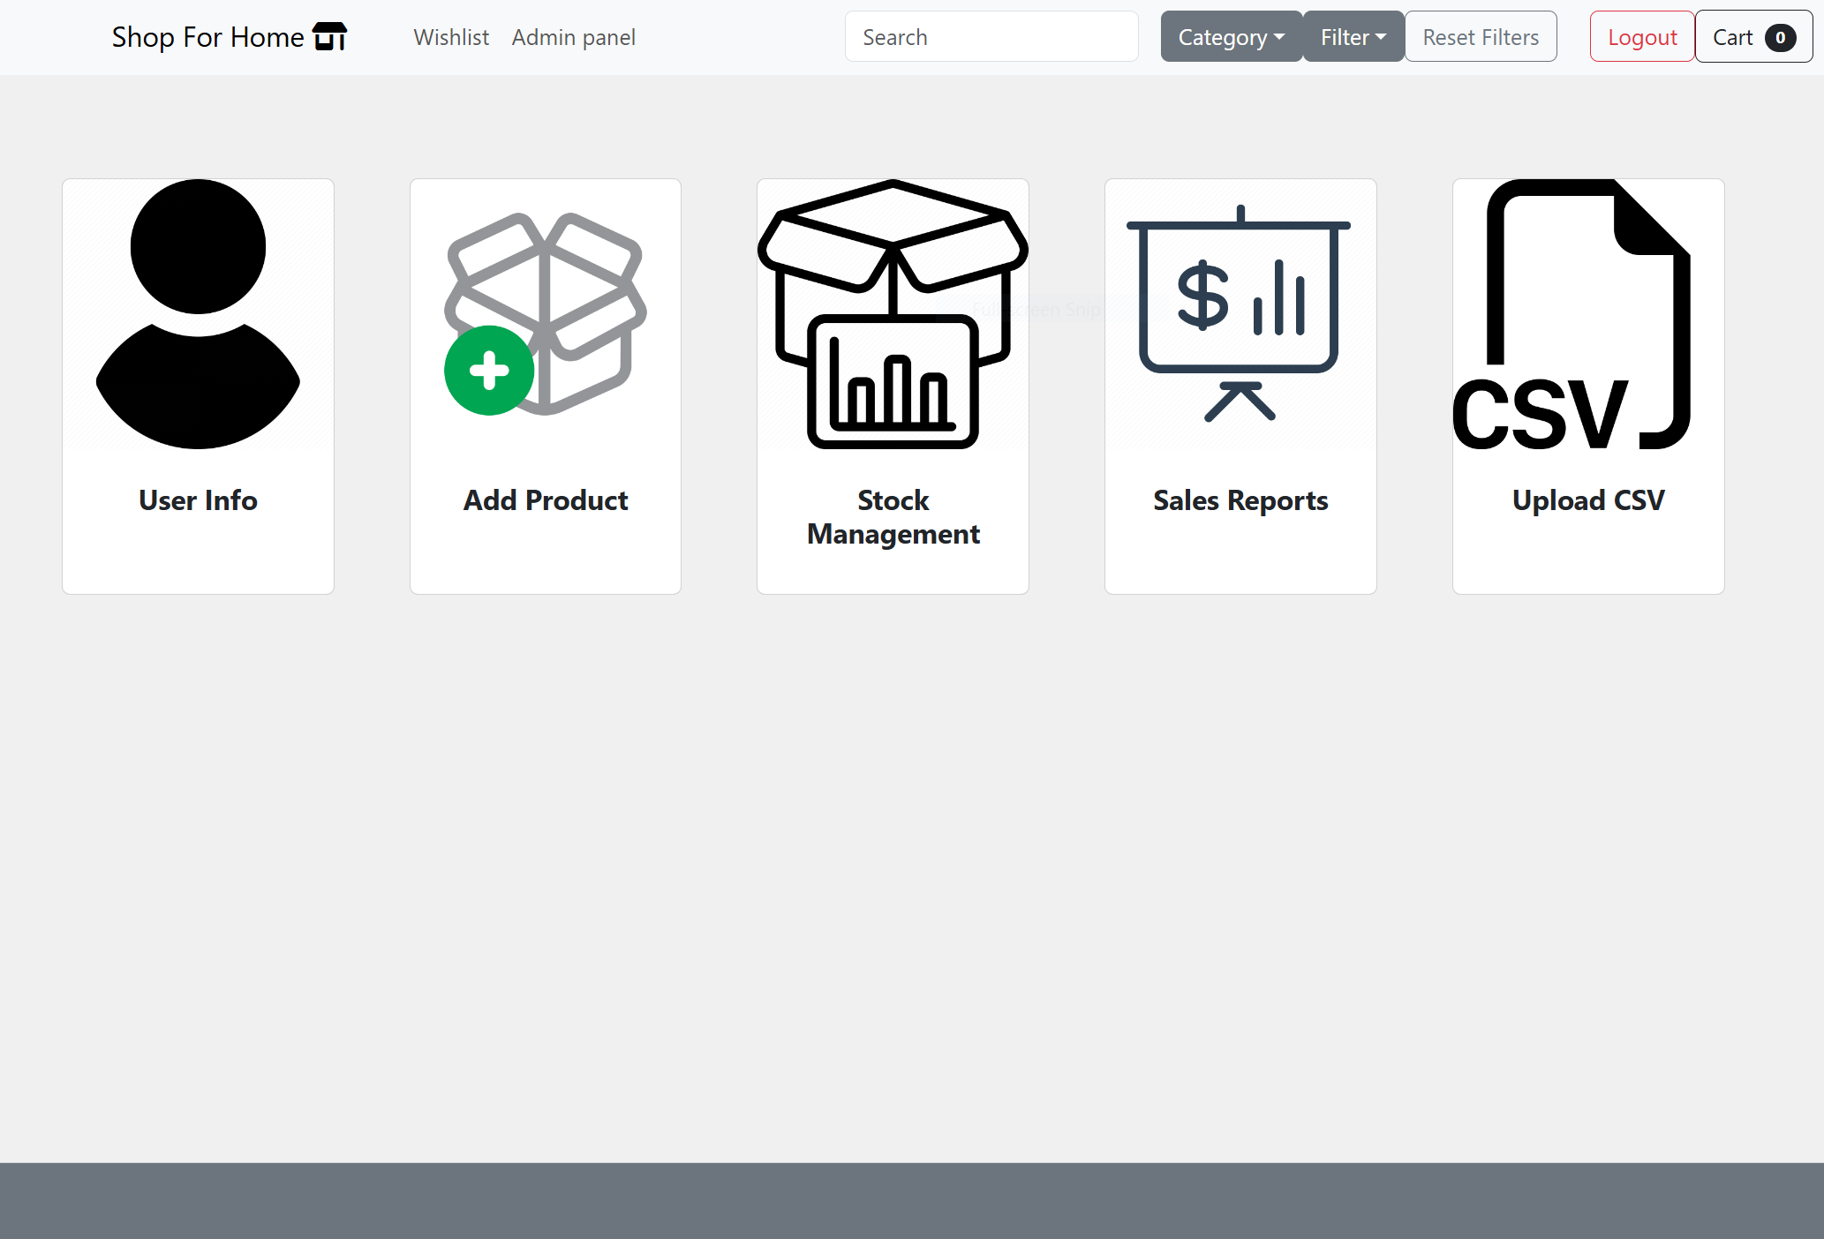
Screenshots of Implementation
Admin Panel:

Slide 12
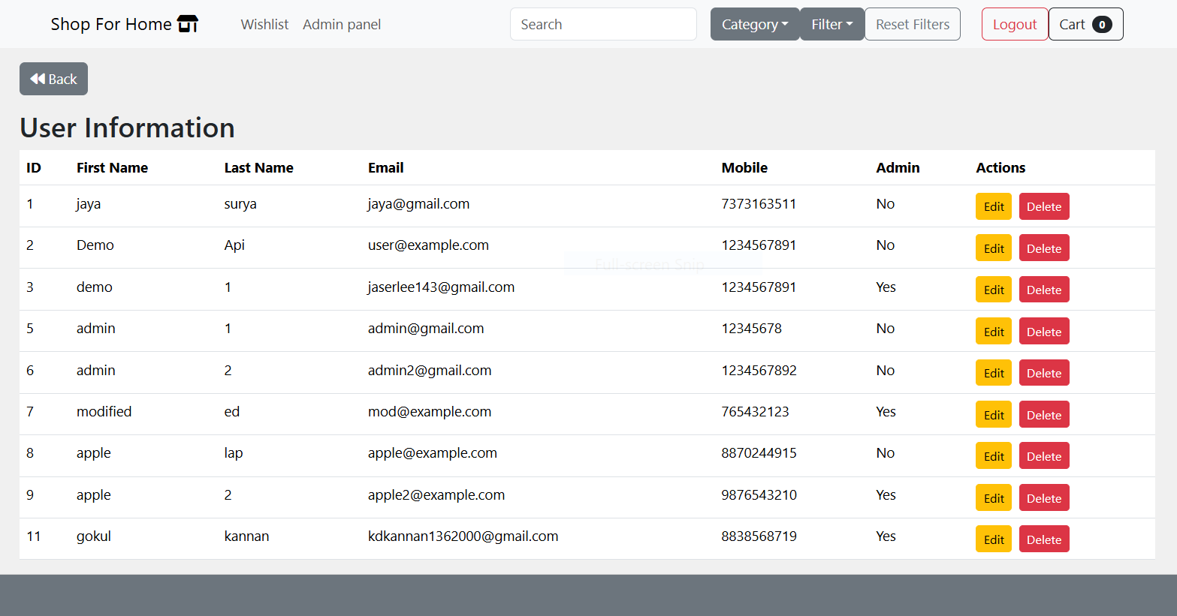
Screenshots of Implementation
User Info:

Slide 13
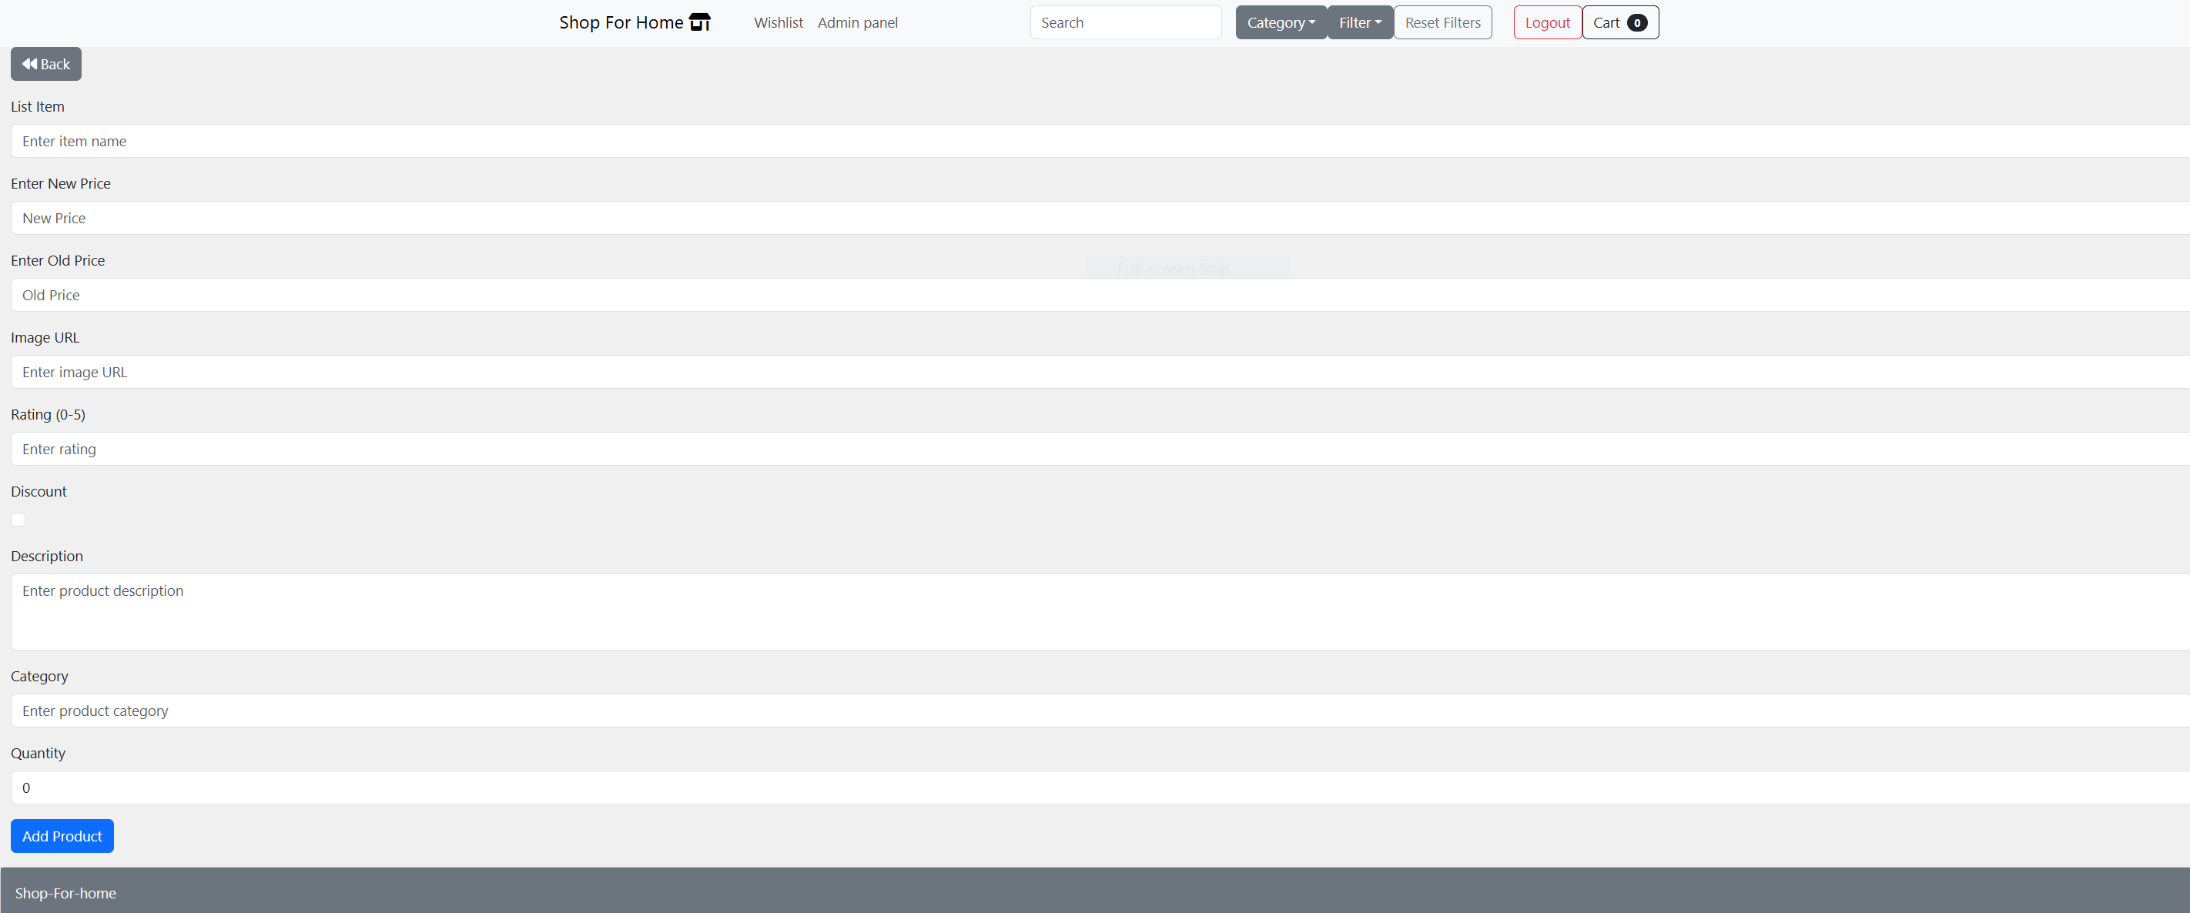
Screenshots of Implementation
Add Product:

Slide 14
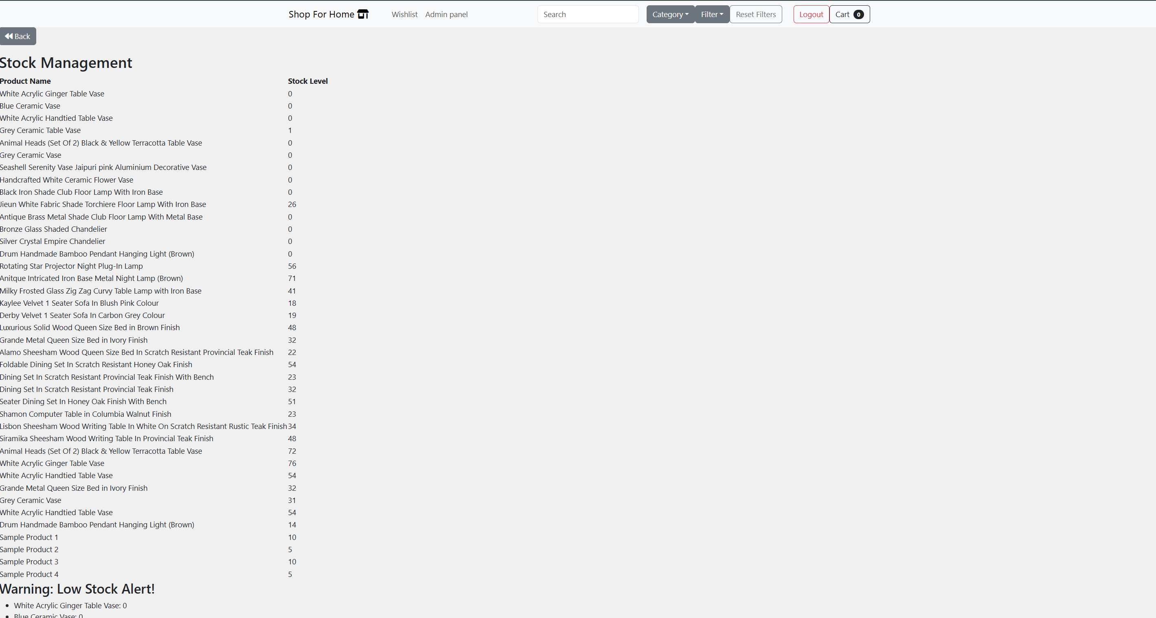
Screenshots of Implementation
Stock Management:

Slide 15
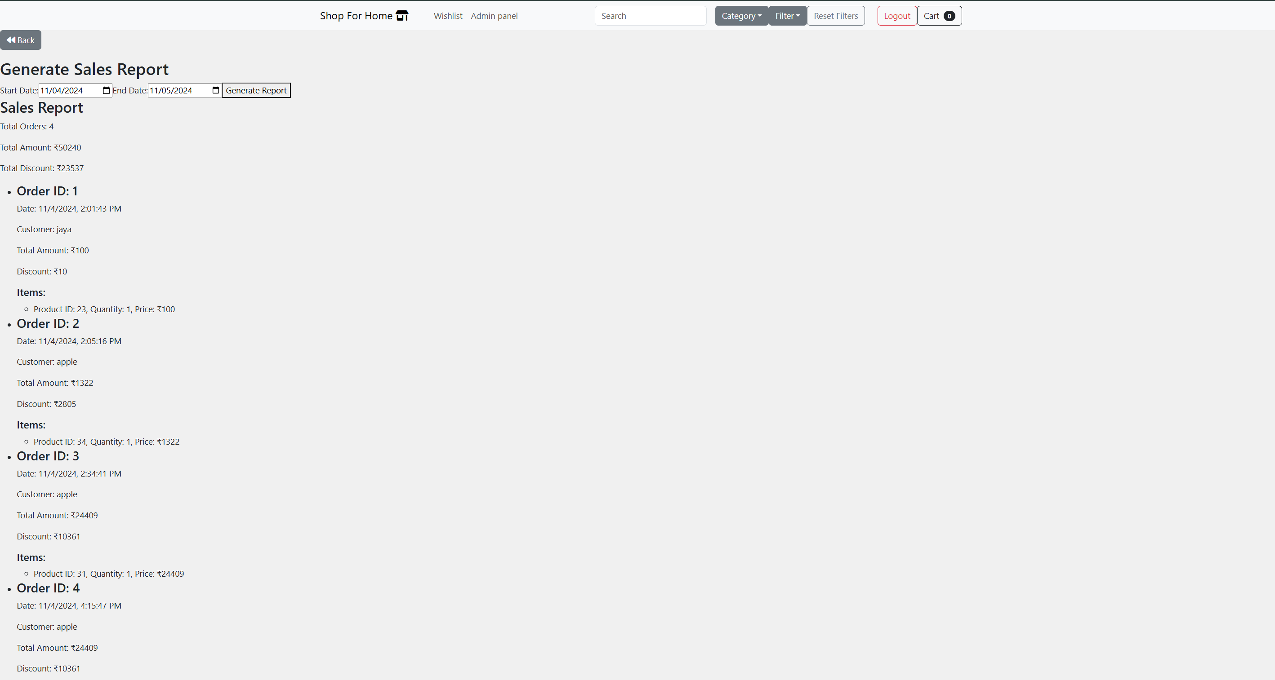
Screenshots of Implementation
Sales Report:

Slide 16
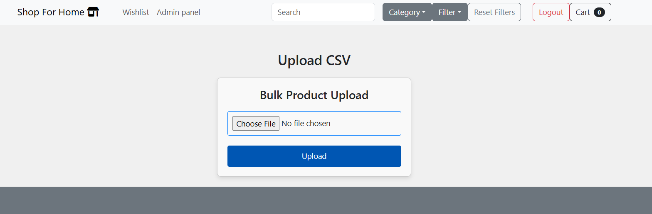
Screenshots of Implementation
Bulk Product Upload:

Slide 17
Sprint Breakdown
Sprint I: Planning & Design
Objectives:
Create the database schema and relationships.
Set up the backend with static HTML views.
Deliverables:
ERD and database schema
Static views for authentication.

Slide 18
Sprint Breakdown
Sprint II: Implementation
Objectives:
Set up frontend routing and main components.
Implement backend CRUD operations for products.
Deliverables:
Fully functional user authentication
API endpoints for product management.

Slide 19
Sprint Breakdown
Sprint III: Final Features & Integration
Objectives:
Implement advanced features like discount coupons.
Integrate frontend with backend for real-time data exchange.
Deliverables:
Final integrated solution with API documentation.

Slide 20
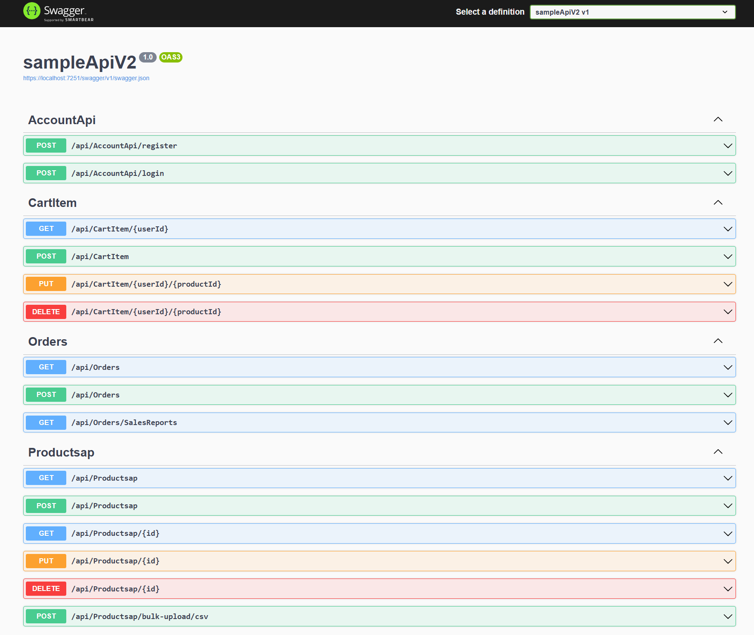
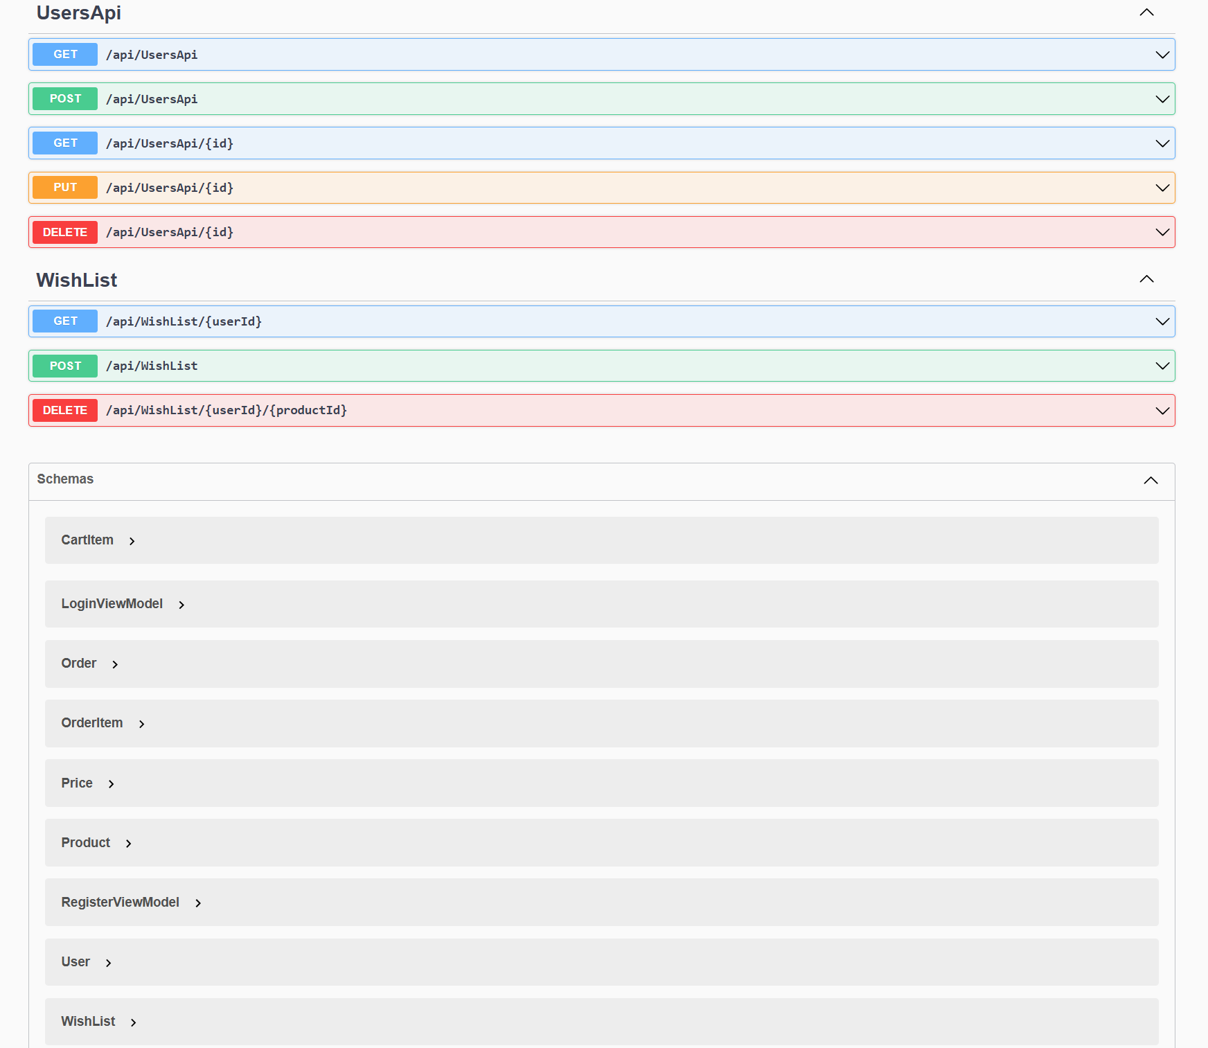
API Documentation (Swagger)
Screenshot of Swagger UI:

Slide 21
Challenges Faced
Challenge 1:
One of the main challenges in the project was effectively managing state, especially for dynamic features like the shopping cart and user sessions.
In my case, React useState was primarily used for managing the cart items, quantities, and user session data, but the challenge was ensuring that this state was properly synchronized across various components
Challenge 2:
Handling Concurrent API Requests
Managing multiple concurrent API requests, especially when fetching product details or updating the shopping cart, led to performance bottlenecks.

Slide 22
Future Scope
Feature Enhancements:
Role-based access control to restrict admin functionalities.
Performance Improvements:
Optimizing image loading times and database query efficiency for better user experience.
Conclusion
The Shop For Home project successfully implements key features that address the needs of users transitioning to online shopping. The application leverages a modern tech stack, ensuring a responsive and secure platform. Future enhancements will further improve usability and scalability.

